Slide 1


MACHINE LEARNING
Group Project: Practice 5
Group 14
3-LAYER FORWARD NN WITH BP

Slide 2

Members & Division of Labor
Edmund Sowah
Zeinab Dehghan
Prince O. Y. Amoako
Dore-Natteh Doris
Members
Zarrin Mahdavipour
Nguyen Dinh Hai
Edmund Sowah
Zeinab Dehghan
Codes & Analysis
Prince O. Y. Amoako
Dore-Natteh Doris
Zarrin Mahdavipour
Nguyen Dinh Hai
PPT
Edmund Sowah

Slide 3
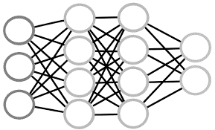
ARTIFICIAL NEURAL NETWORKS
Brief Explanation . Hypothesis . Structure

Slide 4
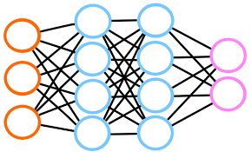
What is a Artificial Neural Network?
… it is inspired by neurons in human brains – over 100 billion
… also called a multilayer perceptron
… a neural network is a collection of neurons connected by synapses.
Neurons
Synapses
Input Layer
Hidden Layer
This collection is organized into three main layers: the input layer, the hidden layer, and the output layer.
Output Layer

Slide 5
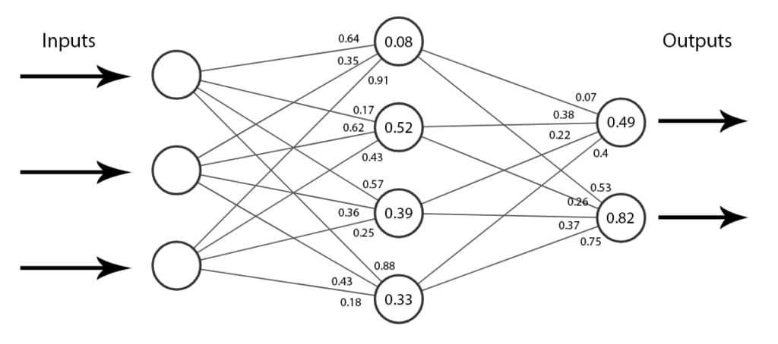
What is a Artificial Neural Network?
These neural networks try and approximate a function f(X) where X are the inputs that get fed forward through the network to give us an output.
The lines connecting the network’s nodes (neurons) are called weights, typically numbers (floats) between 0 and 1.
Bias Unit (ß_{l})
Weights (W_{l})
Each neuron has a bias unit (a float between 0 and 1) that helps shift the results.
X · W_{l} + ß_{l}

Slide 6
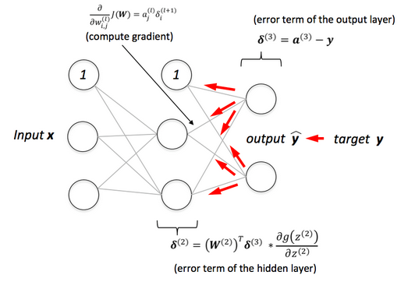
What is a Back-Propagation?
… is an algorithm widely used in the training of feedforward neural networks
for supervised learning; generalizations exist for other artificial neural networks
(ANNs), and for functions generally.

Slide 7


IMPLEMENTING A FLEXIBLE NEURAL NETWORK

Slide 8
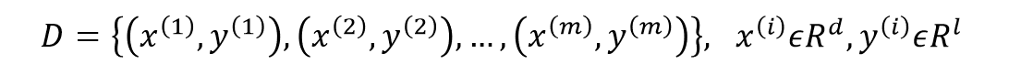
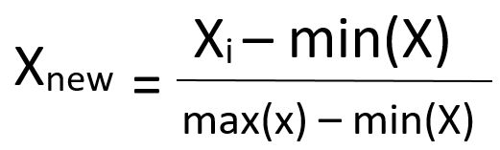
1. INPUT DATA SET
2. Normalize Data
3. Separate data to train and test data for 5-fold cross validation
We can normalize the data so that it has zero mean and one standard deviation,
this is called as Standard Normal Distribution.
4. Initialize all parameters within (0,1) randomly
Hidden layer weight (v) and bias (gamma), output layer (w) and bias (theta), learning rate, number of hidden layer nodes and number of epoch (repeat).

Slide 9
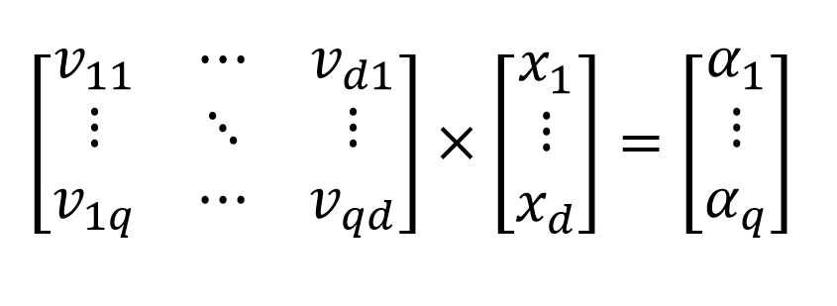
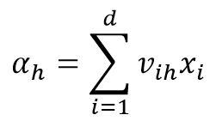

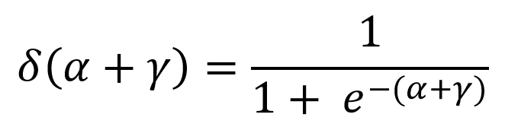
5. For all Train Data:
5.1 Calculate 𝑦
1 – Calculate alpha with each train data (x) by hidden layer weight (v)
2 – Calculate hidden layer nodes (b) by activation function
Binary Sigmoid function

Slide 10
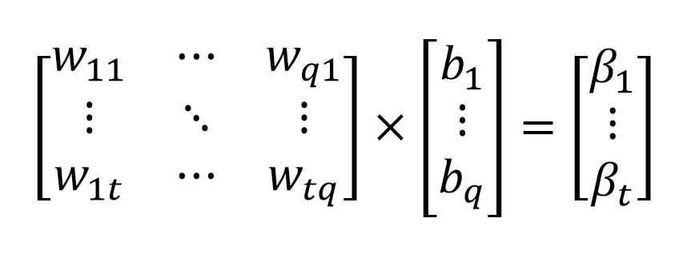
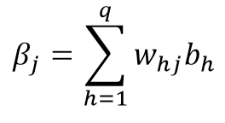

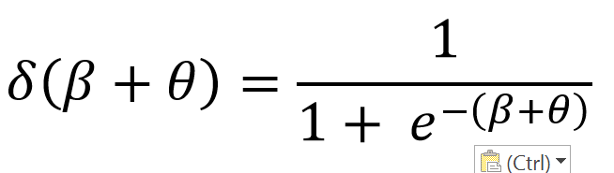
5. For all Train Data:
5.2 Calculate 𝑦
1 – Calculate Beta with each hidden layer nodes (b) by output layer weight (w)
2 – Calculate predicted y by activation function
Binary Sigmoid function

Slide 11
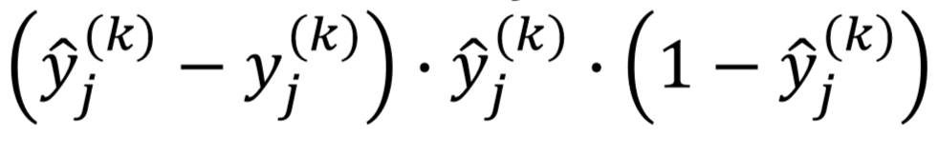
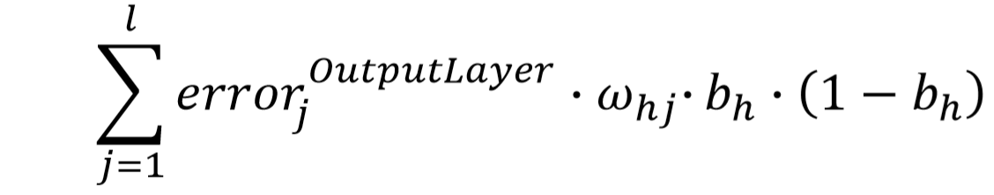

5.2 Calculate Output Layer Error
5.3 Calculate Hidden Layer Error
5.4 Update the Parameters

Slide 12
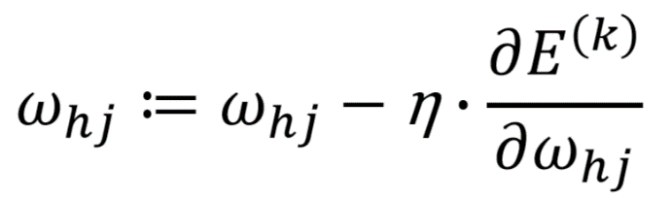
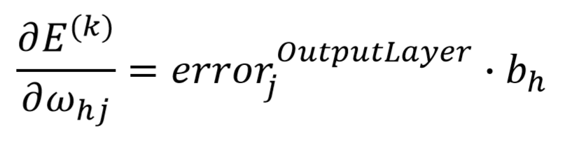
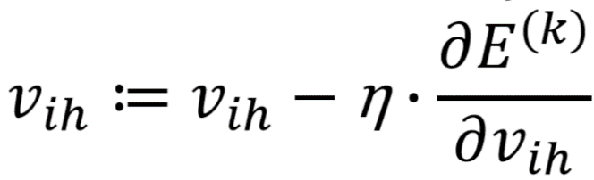
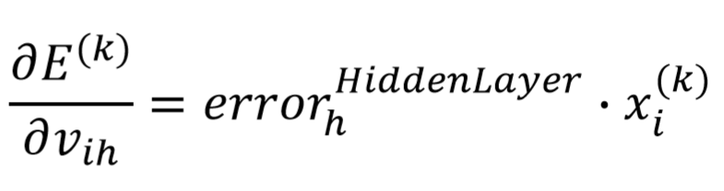
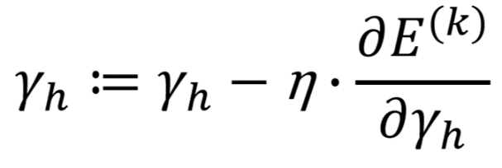
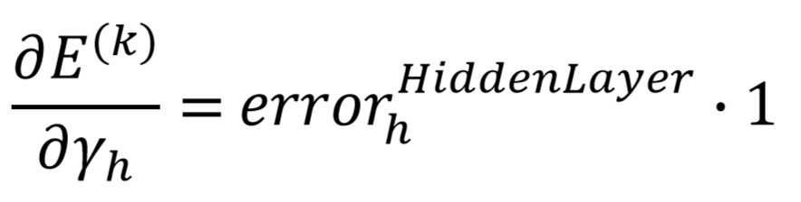
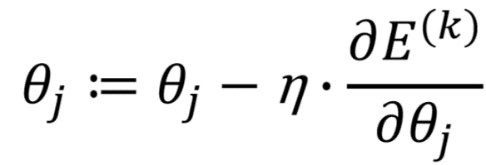
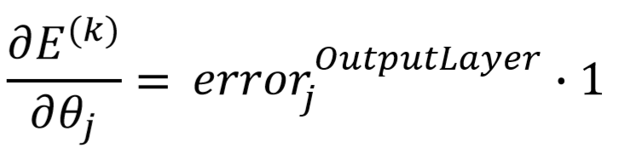
5.4 Update the Parameters …
1
2
3
4

Slide 13

ANALYSIS
ANN with logistic regression on data set (1)
ANN with softmax regression on data set (2)
draw the classification boundaries for all datasets and algorithms

Slide 14
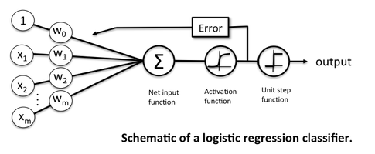
ANN WITH LOGISTIC REGRESSION ON DATA SET (1)
The “classic” application of logistic regression model is binary classification. Although there are kernelized variants of logistic regression exist, the standard “model” is a linear classifier. Thus, logistic regression is useful if we are working with a dataset where the classes are more or less “linearly separable.”
Data Set 1 is linearly separable and directly usable in ANN analysis.
Neural networks are somewhat related to logistic regression. Basically, we can think of logistic regression as a one layer neural network.

Slide 15
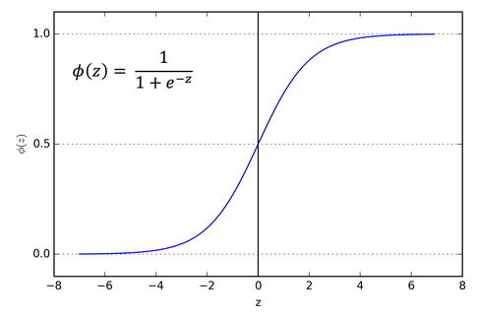
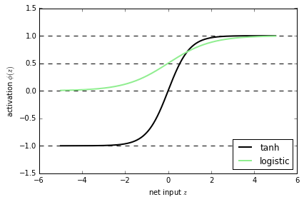
ANN WITH LOGISTIC REGRESSION ON DATA SET (1)
It is very common to use logistic sigmoid functions as activation functions in the hidden layer of a neural network.
Although, neural networks (multi-layer perceptrons to be specific) may use logistic activation functions, the hyperbolic tangent (tanh) often tends to work better in practice, since it’s not limited to only positive outputs in the hidden layer(s).

Slide 16
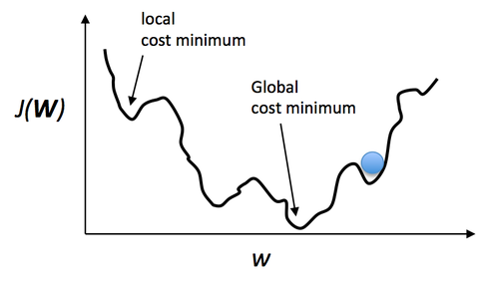
ANN WITH LOGISTIC REGRESSION ON DATA SET (1)
One of the nice properties of logistic regression is that the logistic cost function (or max-entropy) is convex, and thus we are guaranteed to find the global cost minimum. But, once we stack logistic activation functions in a multi-layer neural network, we’ll lose this convexity.
However, in practice, backpropagation works quite well for 2 or more layer neural networks to help with deeper architectures. Even if you may likely converge to a local minima, you often still end up with a powerful predictive model.

Slide 17
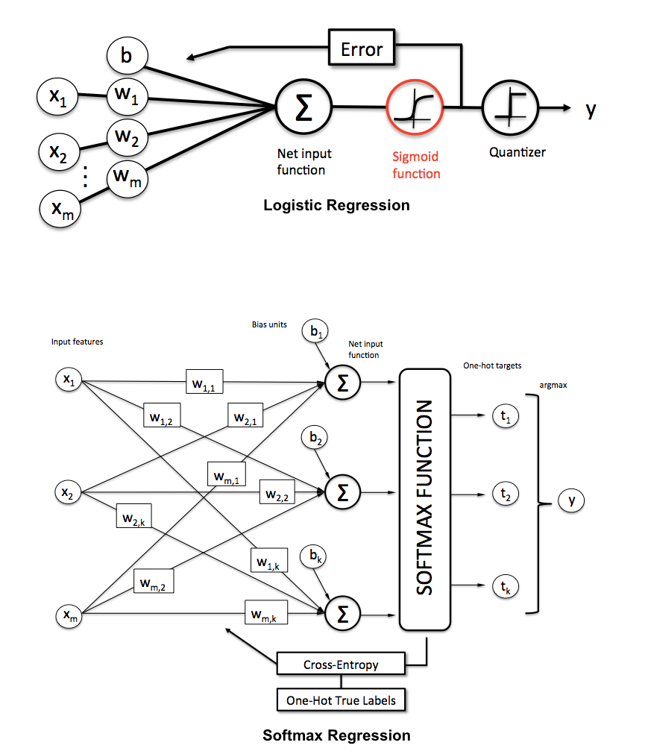
ANN WITH SOFTMAX REGRESSION ON DATA SET (2)
Softmax regression (or multinomial logistic regression) is a generalization of logistic regression to the case where we want to handle multiple classes.
In the softmax regression setting, we are interested in multi-class classification (as opposed to only binary classification), and so the label y can take on K different values, rather than only two. Data Set 2 is made up of three data classes.
Softmax regression (SMR), we replace the sigmoid logistic function by the so-called Softmax function φ

Slide 18
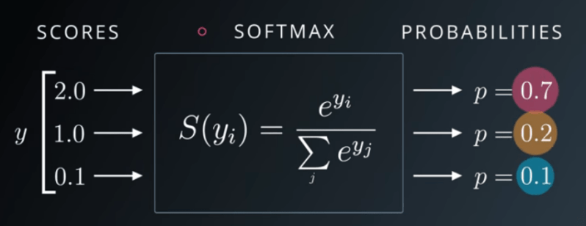
ANN WITH SOFTMAX REGRESSION ON DATA SET (2)
Softmax is not a traditional activation function. For instance, the other activation functions produce a single output for a single input. In contrast, softmax produces multiple outputs for an input array.
For this reason, we can build neural networks models that can classify more than 2 classes instead of binary class solution.
Softmax normalizes the input array in scale of [0, 1]. Also, sum of the softmax outputs is always equal to 1. So, neural networks model classifies the instance as a class that have an index of the maximum output.

Slide 19
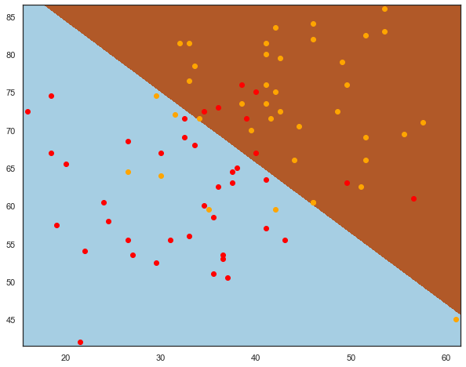
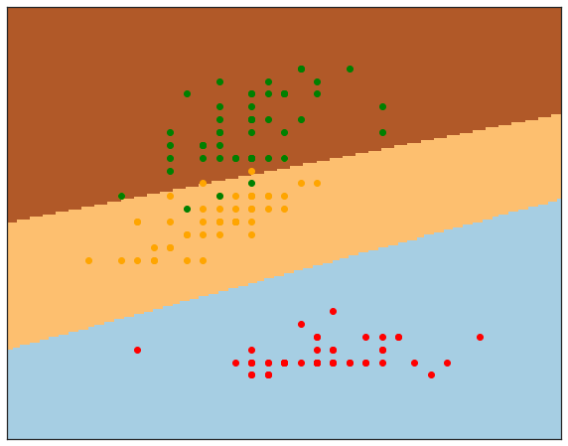
DRAW THE CLASSIFICATION BOUNDARIES FOR ALL DATASETS AND ALGORITHMS
Logistics Regression Decision Boundaries
Data Set 1 – Exam Data
Data Set 2 – Iris Data

Slide 20
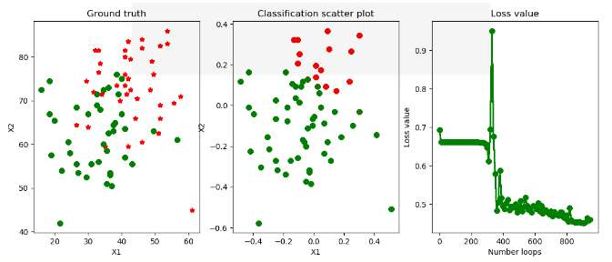
DRAW THE CLASSIFICATION BOUNDARIES FOR ALL DATASETS AND ALGORITHMS

Slide 21
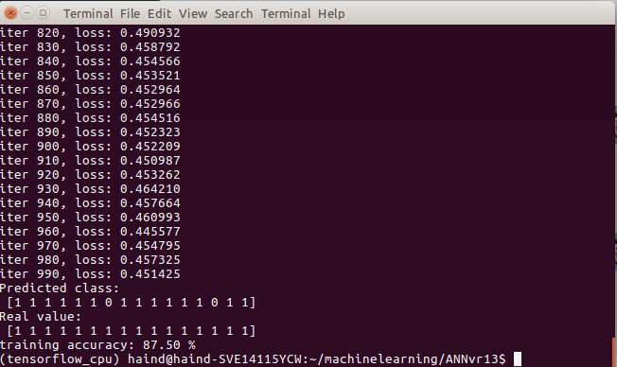
RESULTS FROM THE CODES – Data Set 1 (Exam)
Training Accuracy: 87.50%

Slide 22
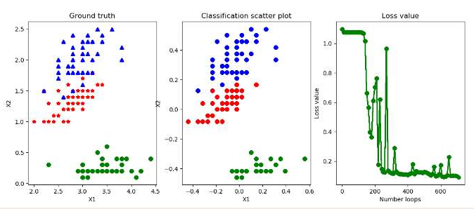
DRAW THE CLASSIFICATION BOUNDARIES FOR ALL DATASETS AND ALGORITHMS

Slide 23
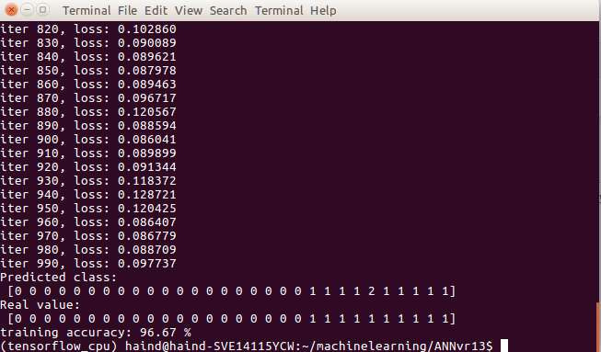
RESULTS FROM THE CODES – Data Set 2 (Iris)
Training Accuracy: 96.67%

Slide 24

CHALLENGES

Slide 25

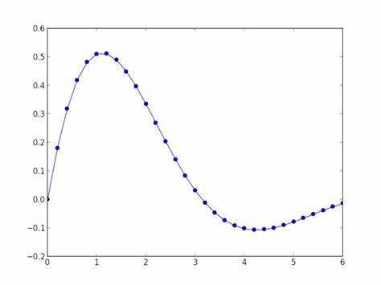
CHALLENGES
1. Animation of results
2. Standardization of data
3. Plotting of boundary graphs

Slide 26

Testing the codes

